Slide 1
Up to speed on Active Learning

Slide 2
Data & Benchmarks
Severity | CWE | Clang Alert | CodeSonar Alert | Clang Rule | CodeSonar Rule | Line | True Positive
High | 119 | 1 | 1 | Buffer Operation | Buffer Overrun | 45 | 1
Low | 561 | 1 | 0 | Dead Code | N/A | 50 | 0
High | 465 | 1 | 0 | Invalid Pointer | N/A | 45 | 0
High | 465 | 1 | 0 | Invalid Pointer | N/A | 104 | 0
High | 465 | 1 | 0 | Invalid Pointer | N/A | 79 | 0
Low | 561 | 1 | 0 | Dead Code | N/A | 104 | 0
Low | 561 | 1 | 0 | Dead Code | N/A | 129 | 0
Low | 561 | 1 | 0 | Dead Code | N/A | 30 | 0
Low | 561 | 1 | 0 | Dead Code | N/A | 71 | 0
Low | 561 | 1 | 0 | Dead Code | N/A | 61 | 0
Data table is made up of output from running both CodeSonar and Clang tools on the Juliet Test Suite.
59875 rows total.
Features are: Severity, CWE, Clang Alert Flag, CodeSonar Alert Flag, Clang Rule, CodeSonar Rule, Line, True Positive
Random Forest: 94.6% Accuracy with 5 folds
Lasso Regression: 87.9% Accuracy with 5 folds
Notes:
93.8% accuracy for xgboost with 1 fold

Slide 3
Alipy Library
Prebuilt library to handle active learning loops
Primarily used their AlExperiment object. Initialization of object takes 7 parameters- independent and dependents variables, the predictive model object from sci-kit learn, performance metric, any stopping criteria, the stopping value, and batch size
Data is then split with split_AL method which takes 4 parameters- test ratio, initial label rate, split count, and whether or not the initially labeled data should include all classes (if possible)
The query strategy is then set with set_query_strategy method. There are a number of choices for simplicity’s sake and the limits of my own understanding I tested three different strategies- Uncertainty, Query by Committee, and Random.
After the loop is start and the experiment is started. Theoretically offers multi-threaded capability but I’ve found it to be buggy.

Slide 4
Query Strategies
Uncertainty- query the row which the model was previously least certain of it’s true value.
Query by Committee- build multiple models on subsets of the data, vote on the value of each row. Query the row which previously had the most split vote.
Random- query a random row each loop.

Slide 5
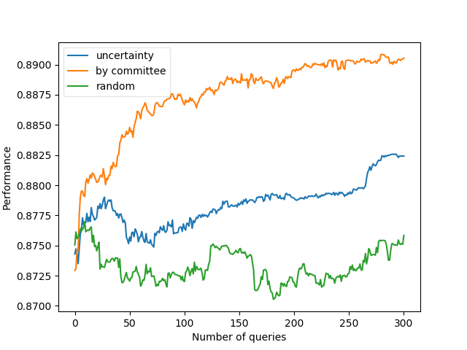
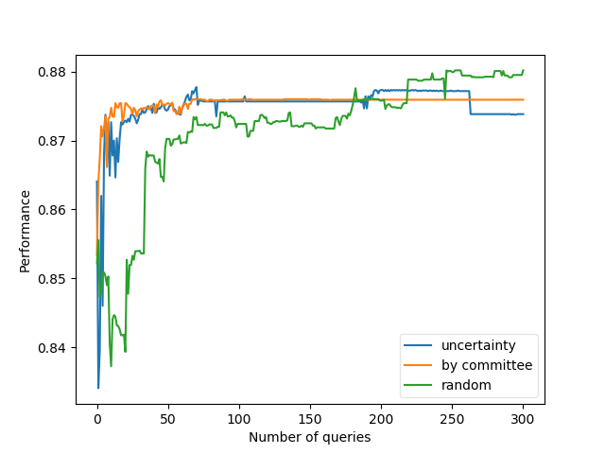
Lasso Logistic Regression Results
300 Initially Labeled, 300 Queries, 5 Folds
25 Initially Labeled, 300 Queries

Slide 6
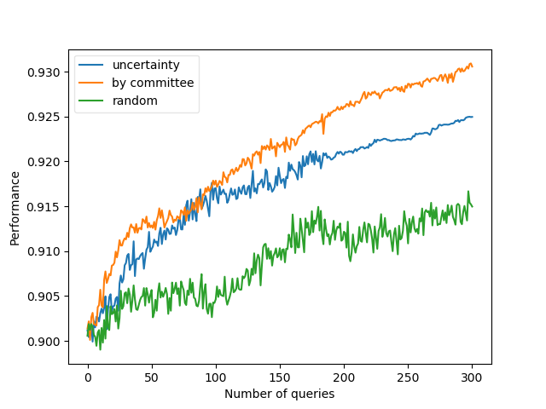
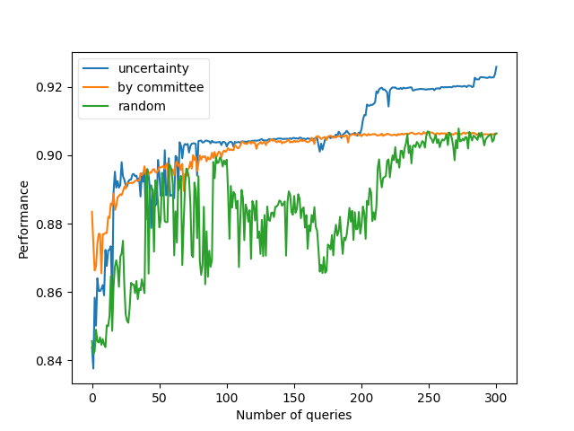
Random Forest Classifier Results
300 Initially Labeled, 300 Queries, 5 Folds
25 Initially Labeled, 300 Queries

Slide 7
Concerns and Limitations
Active Learning Lasso Regression surpasses the static model when given 600 entries. Given the size of the data set, it seems unlikely that this is due to overfitting.
Lasso Regression on the tiny set of 25 initially labelled rows+300 queries approximates the static model for Uncertainty and Committee querying strategy and actually surpasses it with a random querying strategy. Seems extremely strange to me.
Potential reasons for this- overfitting, problems with the alipy library, some sort of flaw in our data.
Data does not come from a true code database, but rather a test suite.
Alipy library does not allow me to change the random seed, so I’m unable to test different seeds using this framework.
Documentation for Alipy is rather spotty, and it’s clear that English is not the author’s first language.

Slide 8
Suggested avenues of exploration
Expand our existing data table with output from the other two tools and potentially cyclomatic complexity measures, see how this then affects our results.
Code the active learning loop by hand, see if I get different results from the Alipy Library.

